Slide 1
Statistical Data Analysis And Modeling Using Rapid Miner
Presented by
Sneha(12mcs1037)
Sravya(12mcs1012)

Slide 2
AGENDA
Objective
Project progress
Statistical Data Analysis
Data Cleaning
ETL process
How we implemented:
Dataset- HIV patients Master chart
Extracting Data from the Dataset
Transforming Data into the Target Form

Slide 3
objective
Vast amounts of statistical information are available in today's global and economic environment because of continual improvements in computer technology. To compete successfully globally, managers and decision makers must be able to understand the information and use it effectively. Methods of data analysis are used in a wide variety of occupations and help people identify, study, and solve many complex problems.
Piles of data are collected and important knowledge is often hidden without anybody knowing. Statistical data analysis and modeling are the best methods to retrieve useful information and manage huge data.

Slide 4
Project progress
Milestones achieved:
Phase1: complete understanding of Statistical Data Analysis and ETL process
Implementing of ETL Process:
Phase2: Data Extraction
Phase3: Data Pre-processing- (Ex:Data Cleaning)
Phase4: Graphic Displays of Descriptive Data Summaries(Scatter Plot-2D/3D, Andrew Curves, Quartile Plot)
Phase5: Outlier Detection

Slide 5
Statistical Data Analysis
Analysis of data is a process of inspecting, cleaning, transforming, and modeling data with the goal of highlighting useful information, suggesting conclusions, and supporting decision making.
Data analysis has multiple facets and approaches, encompassing diverse techniques under a variety of names, in different business, science, and social science domains.

Slide 6
Data Cleaning
Data cleaning is an important procedure during which the data are inspected, and erroneous data are—if necessary, preferable, and possible—corrected.
Data cleaning can be done during the stage of data entry.

Slide 7
ETL Process
Extract-Transform-Load (ETL), is a process that is used to take information from one or more sources, normalize it in some way to some convenient schema, and then insert it into some other repository.
ETL enables physical movement of movement of data from source to target data repository.

Slide 8
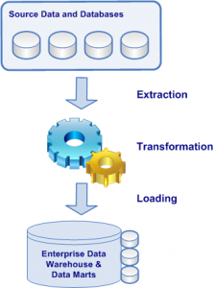
ETL Process
The first step, extraction, is to collect or grab data from from its source(s).
The second step, transformation, is to convert, reformat, cleanse data into format that can be used be the target database.
Finally the last step, loading, is import the transformed data into a target database, data warehouse, or a data mart.

Slide 9
Dataset- HIV patients
Patients information from masterchart
No. of attributes:20
No. of instances:48
No. of missing values:3

Slide 10
DESCRIPTION
Cardiac involvement in AIDS/HIV infected persons occurs frequently. But may be quiescent clinically and may be direct cause of death.
Present study was undertaken to evaluate the cardiac abnormalities In HIV infected patients using electro-cardiogram and echo cardiography.
AIM:To statically analyze the patients with problems from the given data set by correlating with main attributes (BP,PULSE RATE,CD4 COUNT).

Slide 11
Master chart
MAIN ATTRIBUTES:
Preart(pre-antiretro viral therapy no)->primary key
BP (range:100-130/60-90)
pulse rate (range:60-90)
cd4 count: (range:500-1200)
and others….

Slide 12
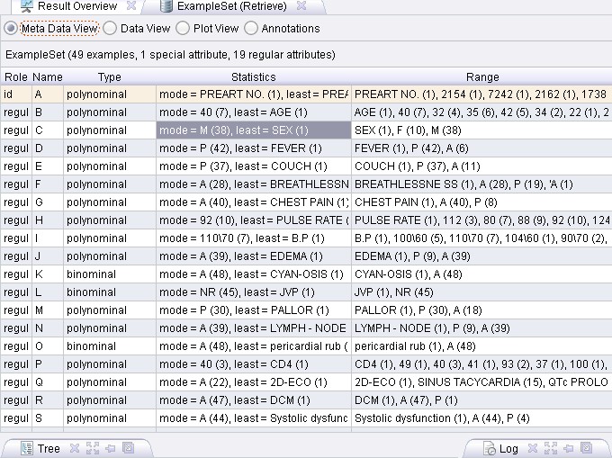
Extracting Data from the Dataset- Meta data view

Slide 13
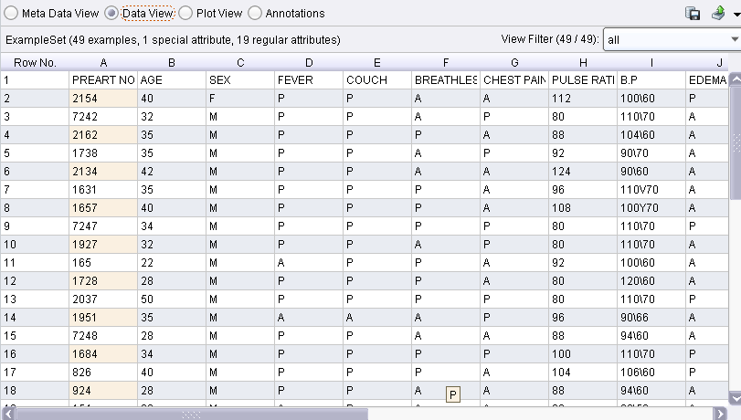
Data view:

Slide 14
DATA PRE-PROCESSING
Inclusion criteria:
age group >15
HIV positive individuals
Exclusion criteria:
Individuals with HIV1 and 2 nonreactive
age group below 15 years
congenital heart diseases

Slide 15
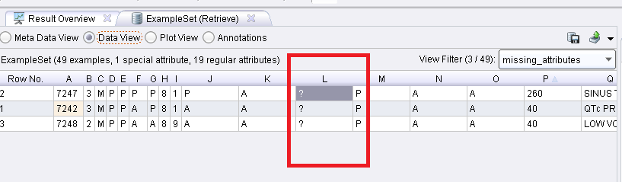
DATA PRE-PROCESSING -Missing values:

Slide 16
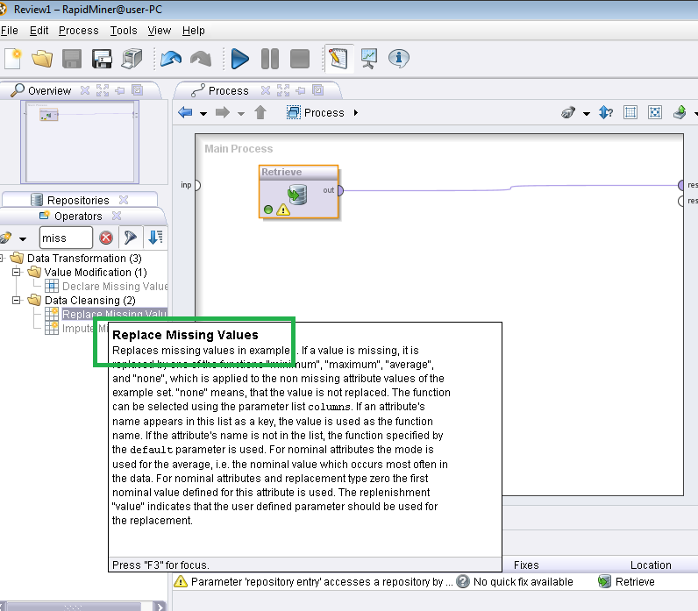
MISSING VALUE REPLACEMENT:

Slide 17
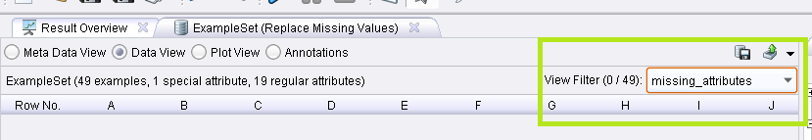
DATA PRE-PROCESSING

Slide 18
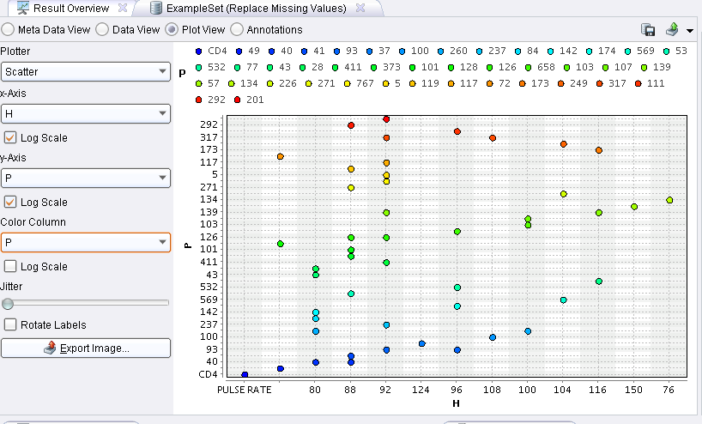
2D- Scatter Plot: CD4

Slide 19
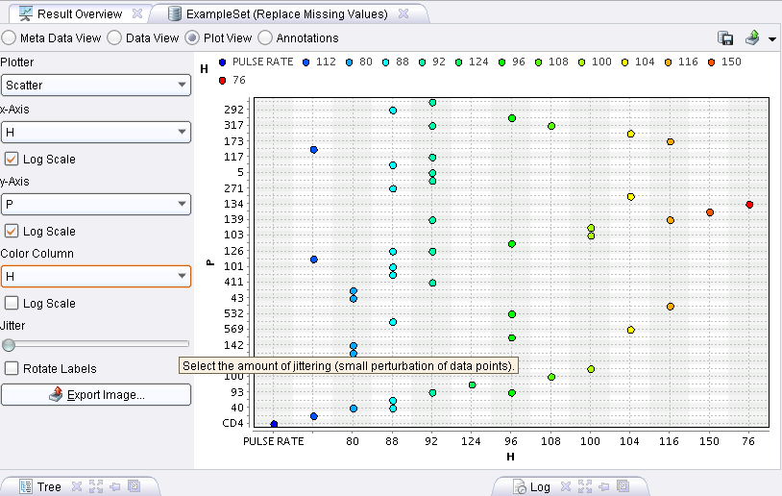
2D- Scatter Plot: Pulse Rate

Slide 20
Andrew Curves
The basic problem of graphical displays of multivariate data is the dimentionality. Scattor plots work well upto 3 dimensions
The idea of coding and representing multivariate data by curves was suggested by Andrew such that each observation represents the co-efficients of a so called fouries series.
Andrew Curves are examples of the space transformed visualization techniques for visualizing multivariate data.

Slide 21
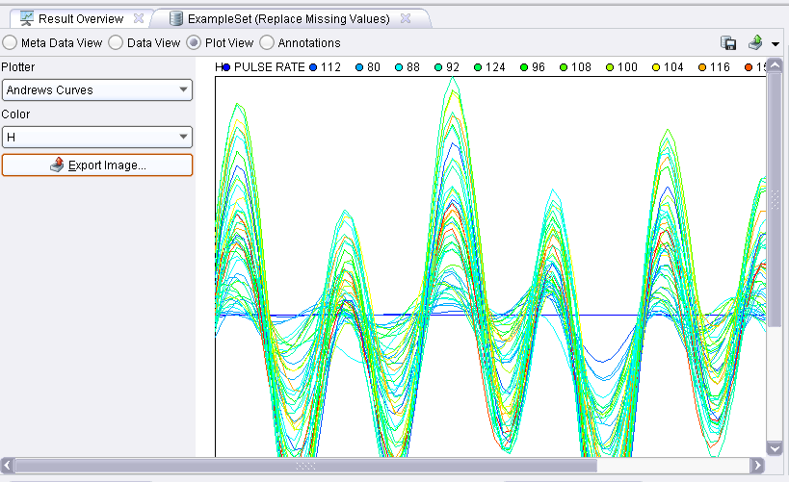
Andrew Curves: Pulse Rate

Slide 22
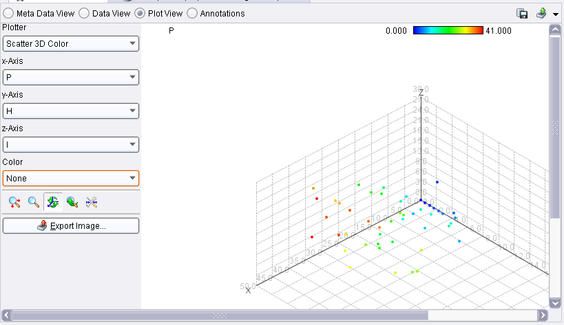
3D Scatter Plot: (CD4, Pulse Rate, BP)

Slide 23
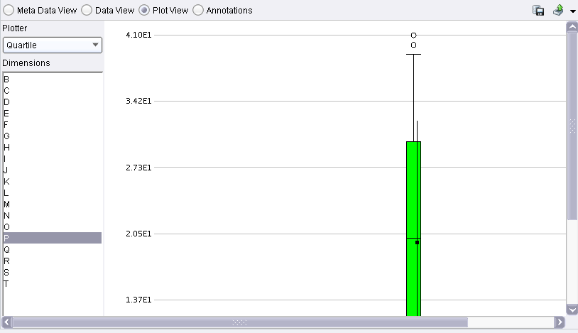
Quartile Plot-CD4

Slide 24
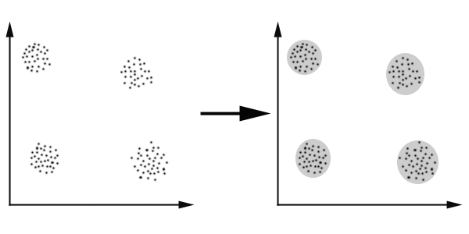
Clustering
Clustering can be considered the most important unsupervised learning problem; so, as every other problem of this kind, it deals with finding a structure in a collection of unlabeled data. A cluster is therefore a collection of objects which are “similar” between them and are “dissimilar” to the objects belonging to other clusters. We can show this with a simple graphical example:

Slide 25
Distance Measure
An important component of a clustering algorithm is the distance measure between data points.
If the components of the data instance vectors are all in the same physical units then it is possible that the simple Euclidean distance metric is sufficient to successfully group similar data instances.

Slide 26
Euclidean distance.
This is probably the most commonly chosen type of distance.
It simply is the geometric distance in the multidimensional space.
It is computed as:
distance(x,y) = {_{i} (x_{i} - y_{i})² }^{½}

Slide 27
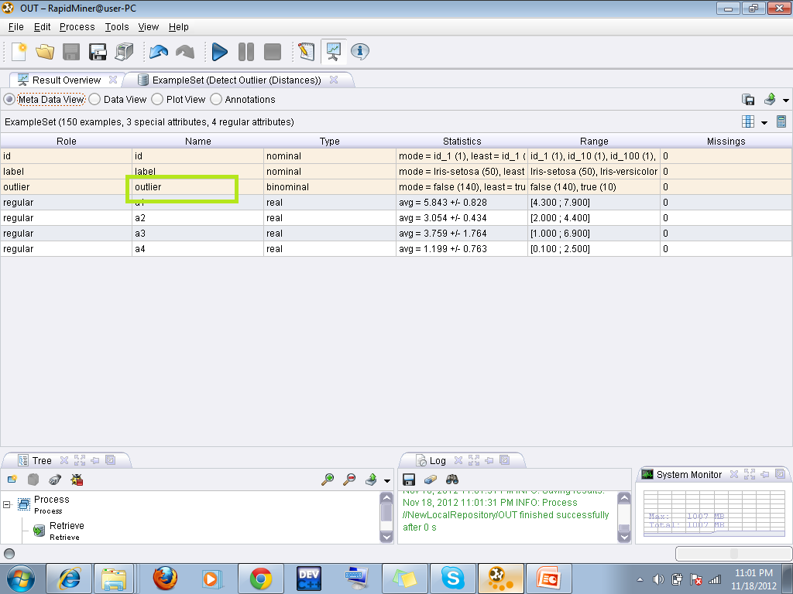
Outlier detection (euclidian distance method)

Slide 28
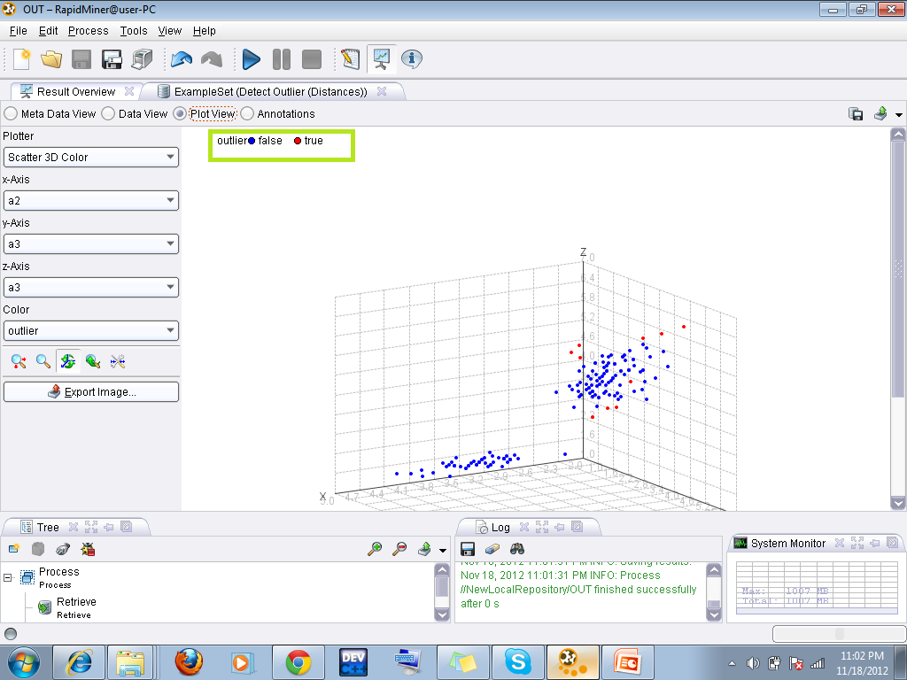

Slide 29
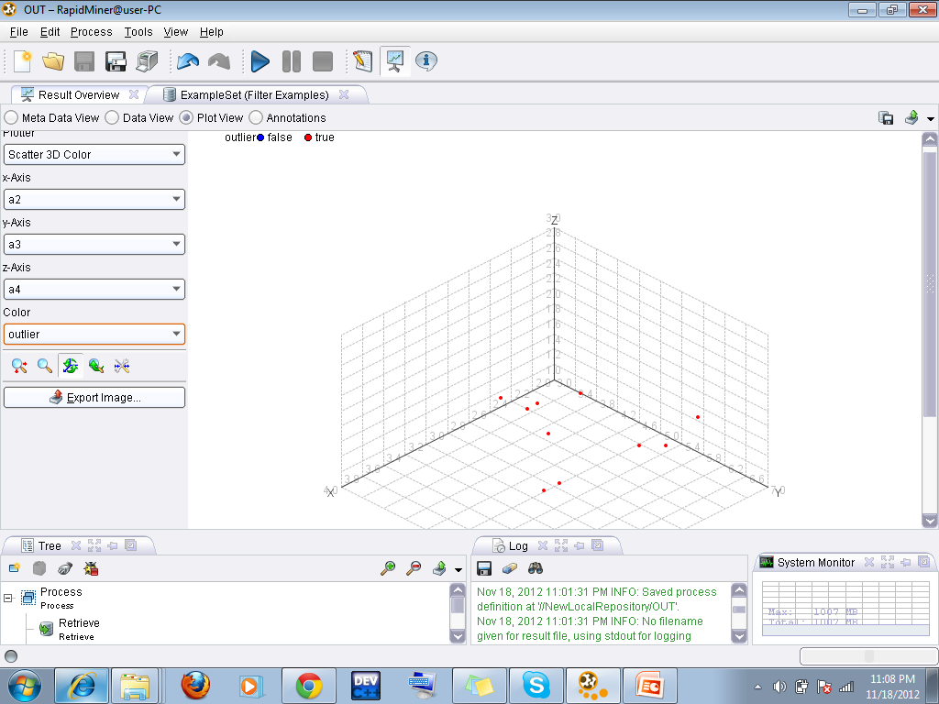

Slide 30
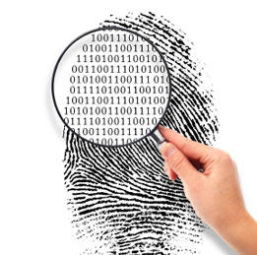
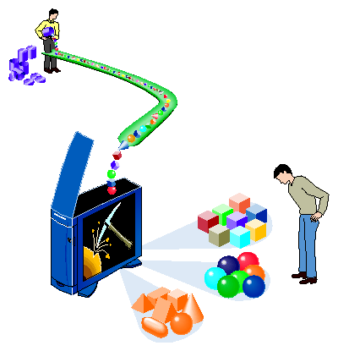
Thank You
Thank You

